Slide 1
AAA Challenge
Initial Data Observation

Slide 2
Checking
Training: 8,000 rows, 53 columns
Testing: 2,000 rows, 53 columns (including all zero target variables)
Initial Exclusion
ID
Admission Date
Diag. 1,2,3 description
Discharge Deposition ID
Admission Source ID

Slide 3
Missing Values
Weight (0.96%)
Payer Code (0.53%)
Medical Specialty (0.41%)

Slide 4
Zero Variance
7 Variables with zero variance
Acetohexamide
Troglitazone
Examide
Citoglipton
Glimepiride.pioglitazone
Metformin.rosiglitazone
Metformin.pioglitazone

Slide 5
Selected ID
36 Variables with zero variance
[1] "race" "gender" "age"
[4] "admission_type_id" "time_in_hospital" "num_lab_procedures"
[7] "num_procedures" "num_medications" "number_outpatient"
[10] "number_emergency" "number_inpatient" "diag_1"
[13] "diag_2" "diag_3" "number_diagnoses"
[16] "max_glu_serum" "A1Cresult" "metformin"
[19] "repaglinide" "nateglinide" "chlorpropamide"
[22] "glimepiride" "glipizide" "glyburide"
[25] "tolbutamide" "pioglitazone" "rosiglitazone"
[28] "acarbose" "miglitol" "tolazamide"
[31] "insulin" "glyburide.metformin" "glipizide.metformin"
[34] "change" "diabetesMed" "readmitted"

Slide 6
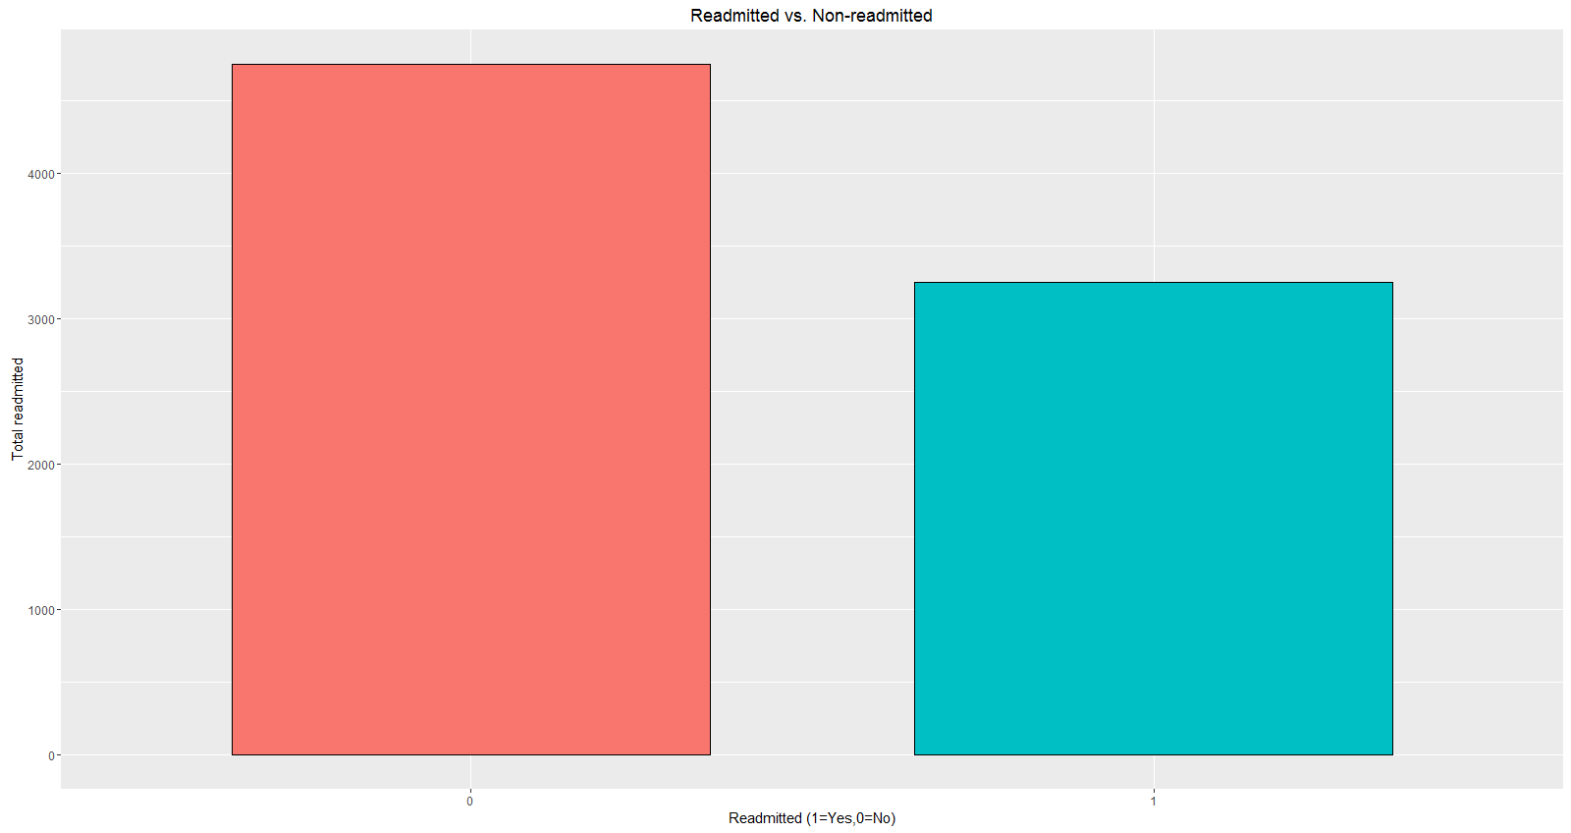
Initial Findings
Target: Yes (59%) No (41%)
Heuristic Model Accuracy (0.6)

Slide 7
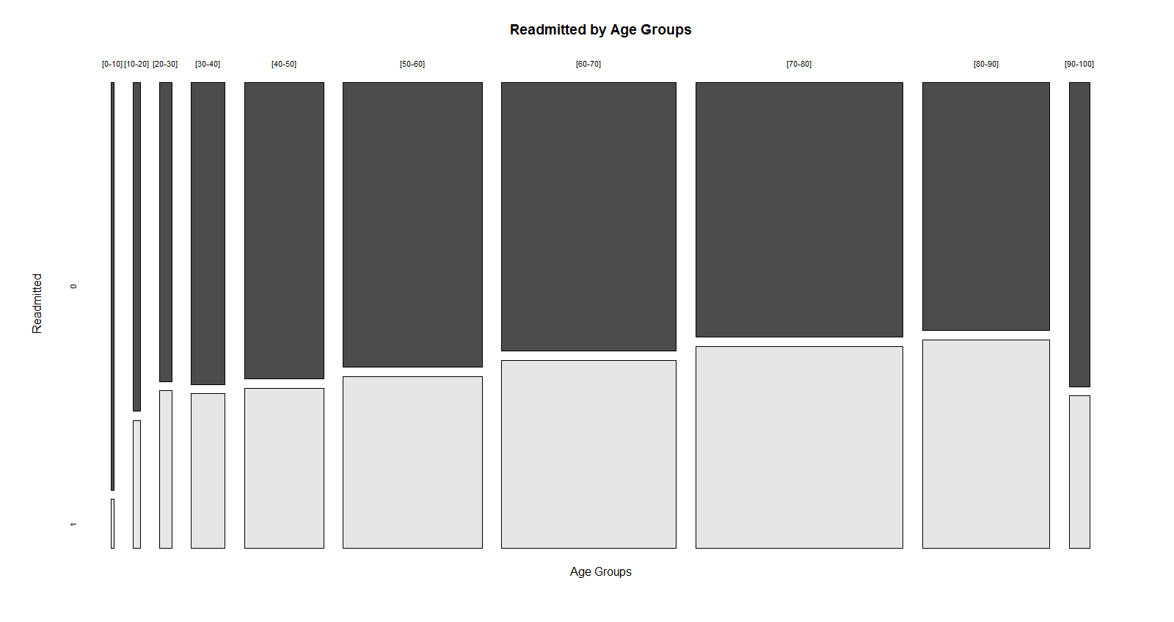
Initial Findings

Slide 8
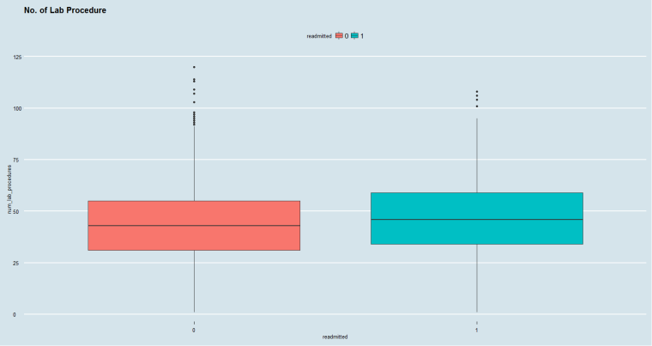
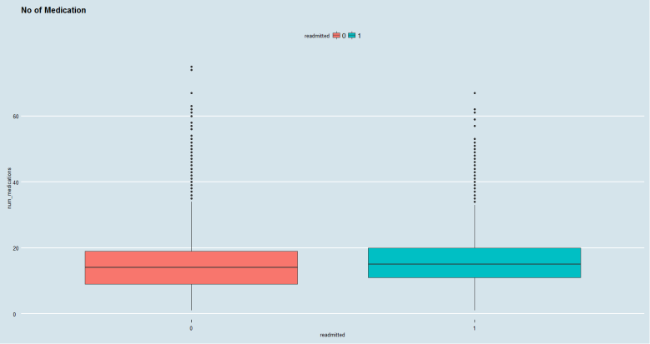
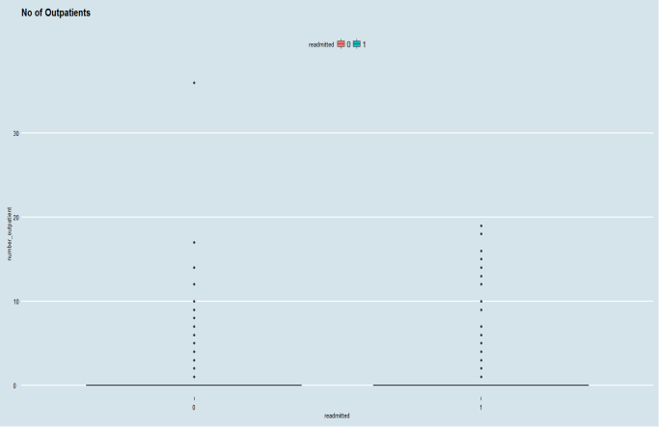
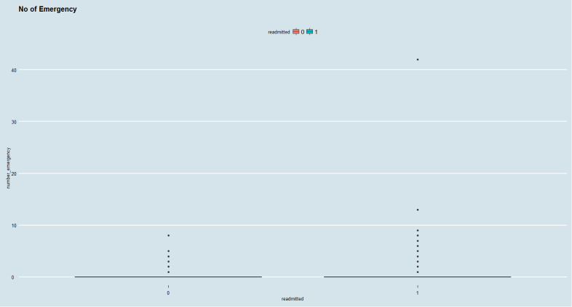
Initial Findings

Slide 9
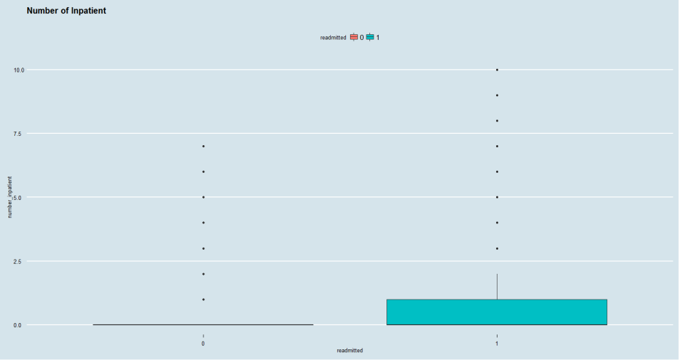
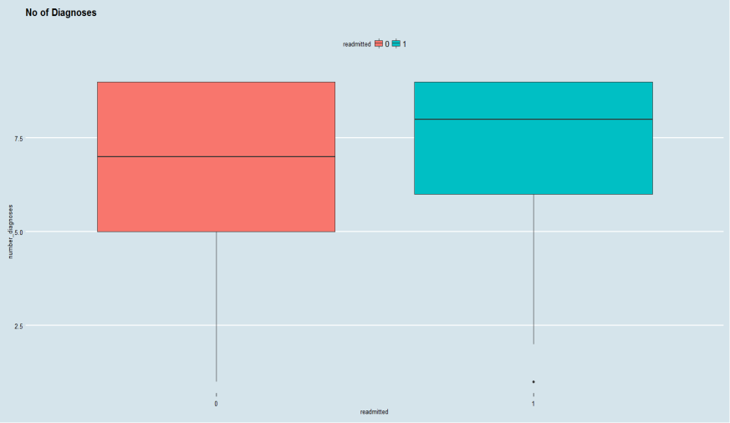
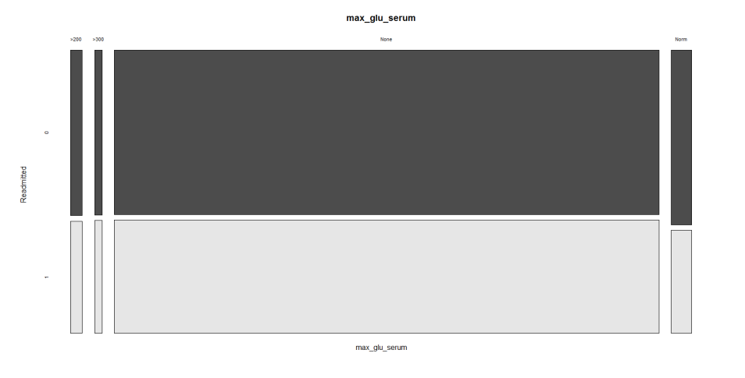
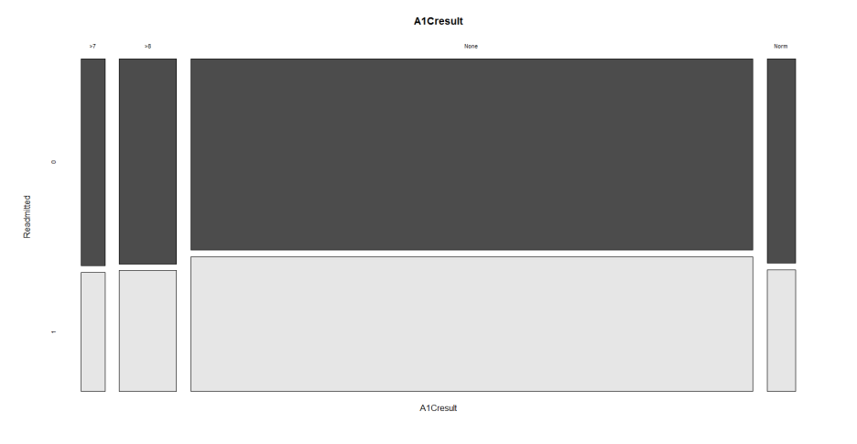
Initial Findings

Slide 10
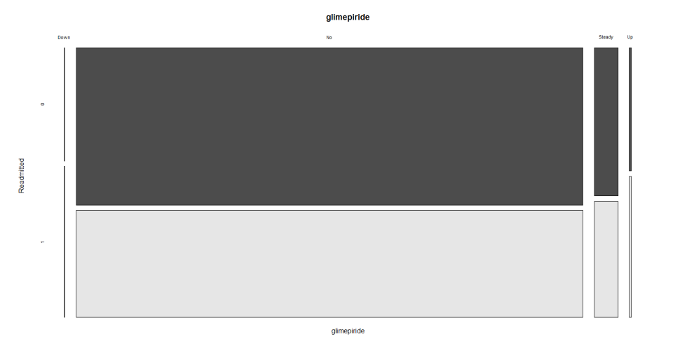
Initial Findings

